Slide 1

CHAP 3: GAUSS’S LAW
1

Slide 2
OBJECTIVES
Calculate the electric flux throw a surface;
Use Gauss’s law to calculate the electric field of symmetric charge distribution;
Some properties of conductors in electrostatic equilibrium.
2

Slide 3
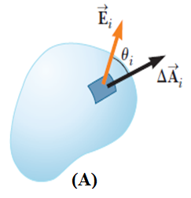


ELECTRIC FLUX
An “electric flux” is the number of electric field lines that penetrates a given surface. we denote the electric flux as Φ_{E}.
- Consider a surface A in an electric field ;
We divided into a large number of small elements, each of area ΔAi.
The electric flux Φ_{E,i} through this element is:
- the total flux through the surface A is:
3

Slide 4


ELECTRIC FLUX
- If the area of each element approaches zero, the number of elements approaches infinity, then
- if the surface is completely closed (sphere or a balloon for example) then the total flux will be:
In this case, the normal of the surface is always from the inside to the outside of the surface (by convention).
- SI Unit of Electric Flux: N.m²/C
- the electric flux can be positive, zero or negative.
4

Slide 5
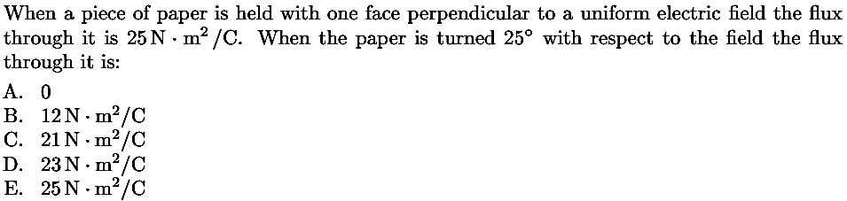
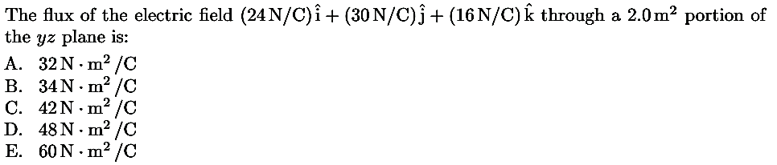
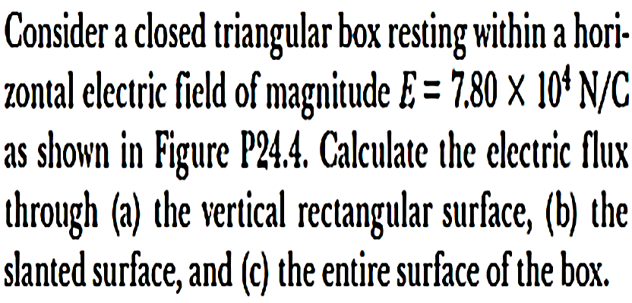
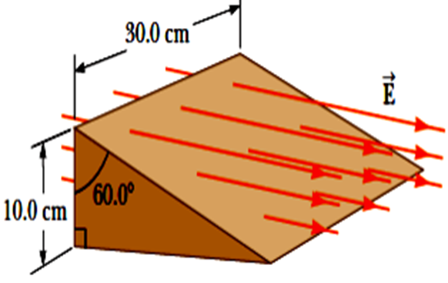
5

Slide 6

Example
An electric field of magnitude 3.50 kN/C is applied along the x axis. Calculate the electric flux through a rectangular plane 0.350 m wide and 0.700 m long
(a) if the plane is parallel to the yz plane;
(b) if the plane is parallel to the xy plane.
Example
A non uniform electric field is given by the expression
where a, b, and care constants. Determine the electric flux through a rectangular surface in the xy plane, extending from x =0 to x = w and from y =0 to y = h.
6

Slide 7

Gauss’s law
Gauss’s law states that the total electric flux through a closed surface (a Gaussian surface), which can be written as the surface integral of the electric field normal to the surface, equals a constant times the total charge enclosed Q_{encl} by the surface.
Gauss’s law is a more convenient for calculating the electric field of highly symmetric charge distributions.
A Gaussian surface is an imaginary surface, created solely to facilitate a mathematical calculation. It doesn’t necessarily coincide with the surface of a physical object.
7

Slide 8
Gauss’s law
The following steps may be useful when applying Gauss’s law:
(1) Identify the symmetry associated with the charge distribution.
(2) Determine the direction of the electric field, and a “Gaussian surface” on which the magnitude of the electric field is constant over portions of the surface.
(3) Divide the space into different regions associated with the charge distribution. For each region, calculate qenc , the charge enclosed by the Gaussian surface.
(4) Calculate the electric flux ΦE through the Gaussian surface for each region
(5) Equate ΦE with qenc/ε0 , and deduce the magnitude of the electric field.
8

Slide 9
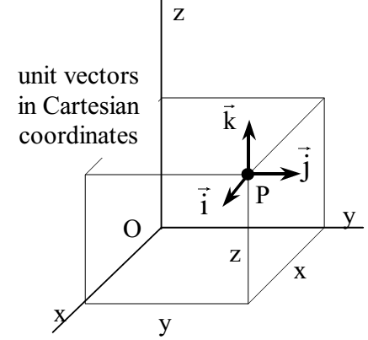

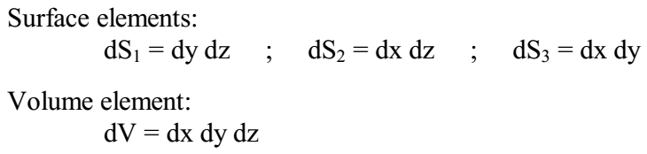
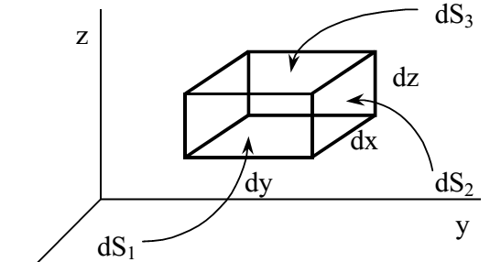
Gauss’s law
Cartesian coordinate system
-x = constant ∈ [–∞,+∞];
-y = constant ∈ [–∞,+∞];
-z = constant ∈ [–∞,+∞].
9

Slide 10
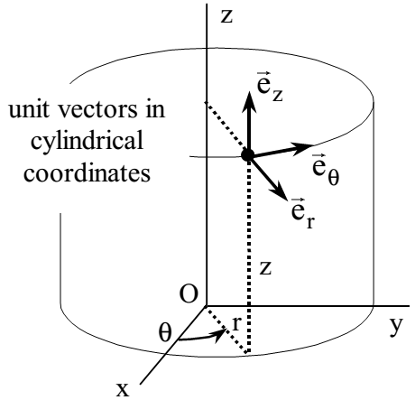

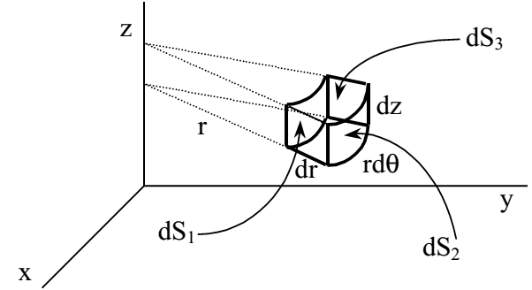
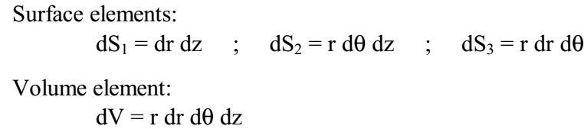
Gauss’s law
Cylindrical coordinate system
- r = constant ∈ [0,+∞]: Radius of the cylinder passing through P
- θ=azimuthal angle: constant ∈ [0,+2π]
- z = constant ∈ [–∞,+∞].
10

Slide 11
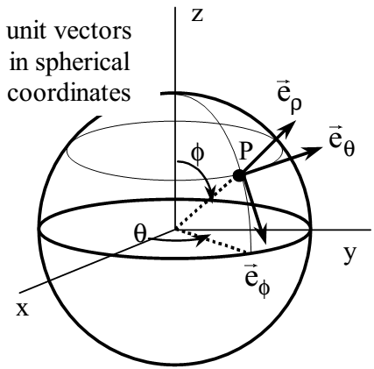

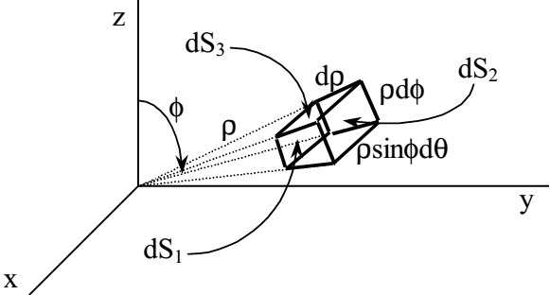
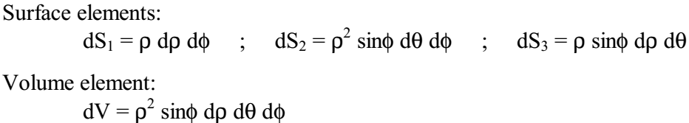
Gauss’s law
Spherical coordinate system
-ρ= constant ∈ [0,+∞]: radius,
-φ= constant ∈ [0,+π]: colatitude (zenith):the angle between the z-axis and the position vector of P
-θ= constant ∈ [0,+2π]: azimuthal angle,
11

Slide 12
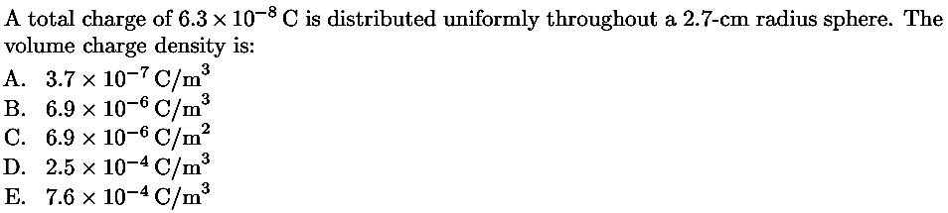
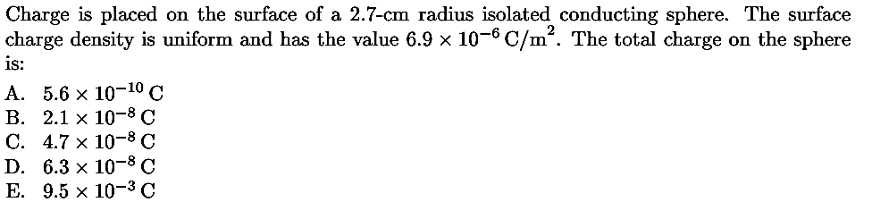
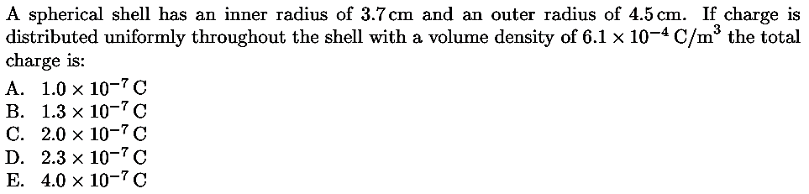
12

Slide 13
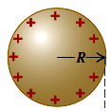
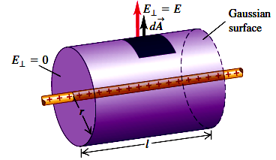
The electric field of a continuous charge distribution
Example 1
Positive electric charge Q is distributed uniformly throughout the volume of an insulating sphere with radius R. Find the magnitude of the electric field at a point P a distance r from the center of the sphere.
Example 2
Electric charge is distributed uniformly along an infinitely long, thin wire. The charge per unit length is λ(assumed positive). Find the electric field using Gauss’s law.
13

Slide 14
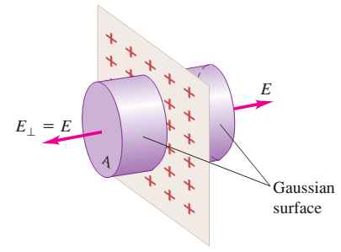
The electric field of a continuous charge distribution
Example
Use Gauss’s law to find the electric field caused by a thin, flat, infinite sheet with a uniform positive surface charge density
14

Slide 15
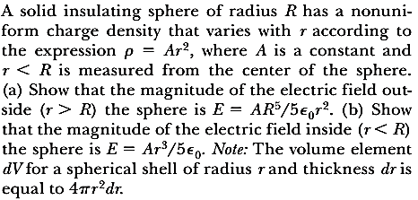
The electric field of a continuous charge distribution
15

Slide 16
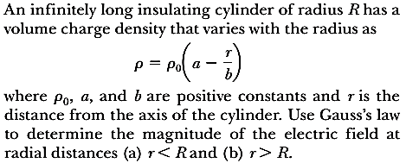
The electric field of a continuous charge distribution
16

Slide 17
Conductors in Electrostatic Equilibrium
we learned that, a good electrical conductor contains charges (electrons) that are not bound to any atom and therefore are free to move about within the material.
When there is no net motion of charge within a conductor, the conductor is in electrostatic equilibrium.
A conductor in electrostatic equilibrium has the following properties:
1. The electric field is zero everywhere inside the conductor, whether the conductor is solid or hollow.
2. If the conductor is isolated and carries a charge, the charge resides on its surface.
3. The electric field at a point just outside a charged conductor is perpendicular to the surface of the conductor and has a magnitude σ/ɛ₀, where s is the surface charge density at that point.
.
17

Slide 18
- Read chapter 25
- Suggested problems: : 3, 9, 13, 24, 27, 29, 31, 33, 45
Test: 24/02/2021 at 02:30 pm
18

